Slide 1


Quick Connect Multi-Sensors Project
Real-Time Air Quality Monitoring

Slide 2
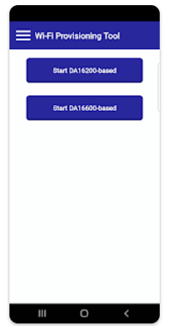
HOW?
AWS Cloud (MQTT protocol)
Air Quality (NO2 & O3) Sensor (ZMOD4510)
RA6E2 MCU
Air Quality (TVOC) Sensor (ZMOD4410)
(Wi-Fi/BLE) DA16600
Humidity & Temperature Sensor (HS4001)
IOS Application

Slide 3
WHY?
Smart Homes & Offices:
Continuous monitoring ensures healthier indoors by detecting harmful pollutants
Healthcare & Research:
Support respiratory health, industrial safety, and environmental studies with accurate scalable solutions
Urban Monitoring:
Deploying IoT-enabled nodes for real-time air quality insights, aiding city planning & pollution controls

